Slide 1


PROJECT ON BLOCKCHAIN MEDICAL RECORD SYSTEM
Submitted By:
SAMEER LOHANI
Course:
Bachelor Of Technology CSE(Cyber Security)
University Roll No.:
2024202
Under Guidance of:
Prof. (Dr.) Mohammad Wazid
Semester:
THIRD

Slide 2
INTRODUCTION
Rapid development in healthcare systems, security and accessibility of medical records have become an important issue today.
The Blockchain Medical Record System makes use of advanced blockchain technology to transform the way medical data is stored, accessed, and managed.
It will solve the issues of data breach, inconsistency in record-keeping, and sharing of information between doctor and patient.
This is expected to create a path towards a safer and more efficient approach to health care.

Slide 3
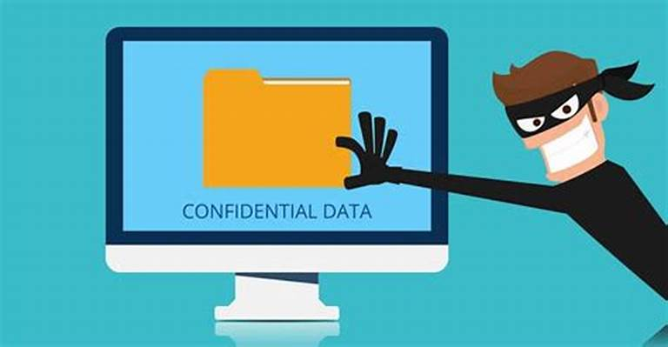

PROBLEM STATEMENT
The problem of unsynchronized or mismatched health records makes it challenging to deliver effective health care.
The Problem Privacy breach for electronic medical records and private information, where sensitive data may be accessed without permission and used improperly.

Slide 4
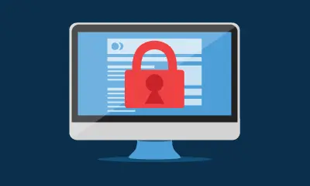
LITRATURE SURVEY
Compared with traditional paper-based medical records , Blockchain Medical Records (BMRs) are widely used because of their eﬀiciency, security, and reducing data redundancy.
The Blockchain Medical Records (BMR) system is a major technological development in healthcare that has completely changed how patient data is collected, stored, and used.
Through the use of cutting-edge digital technologies, the BMR system offers a safe, centralized location for all patient data.

Slide 5

LITRATURE SURVEY
Healthcare personnel may easily access, edit, and share patient information thanks to its user-friendly interfaces, which helps them make more informed clinical decisions and provide better treatment.
The system developed using the Ethereum network using Ganache(I have compiled the programs in Remix IDE). The measured approach is to store patients data and execute functions in a decentralized system using blockchain smart contracts.

Slide 6
OBJECTIVE
To create a blockchain medical record system that improves the delivery of effective healthcare.
To Develop a system that reduce risk of privacy breach.

Slide 7
RESULT AND DISCUSSION
Patients can store and view their data (including name, age, gender, and address), Doctors can access a list of other patients' medical records, and search for specific medical records.

Slide 8
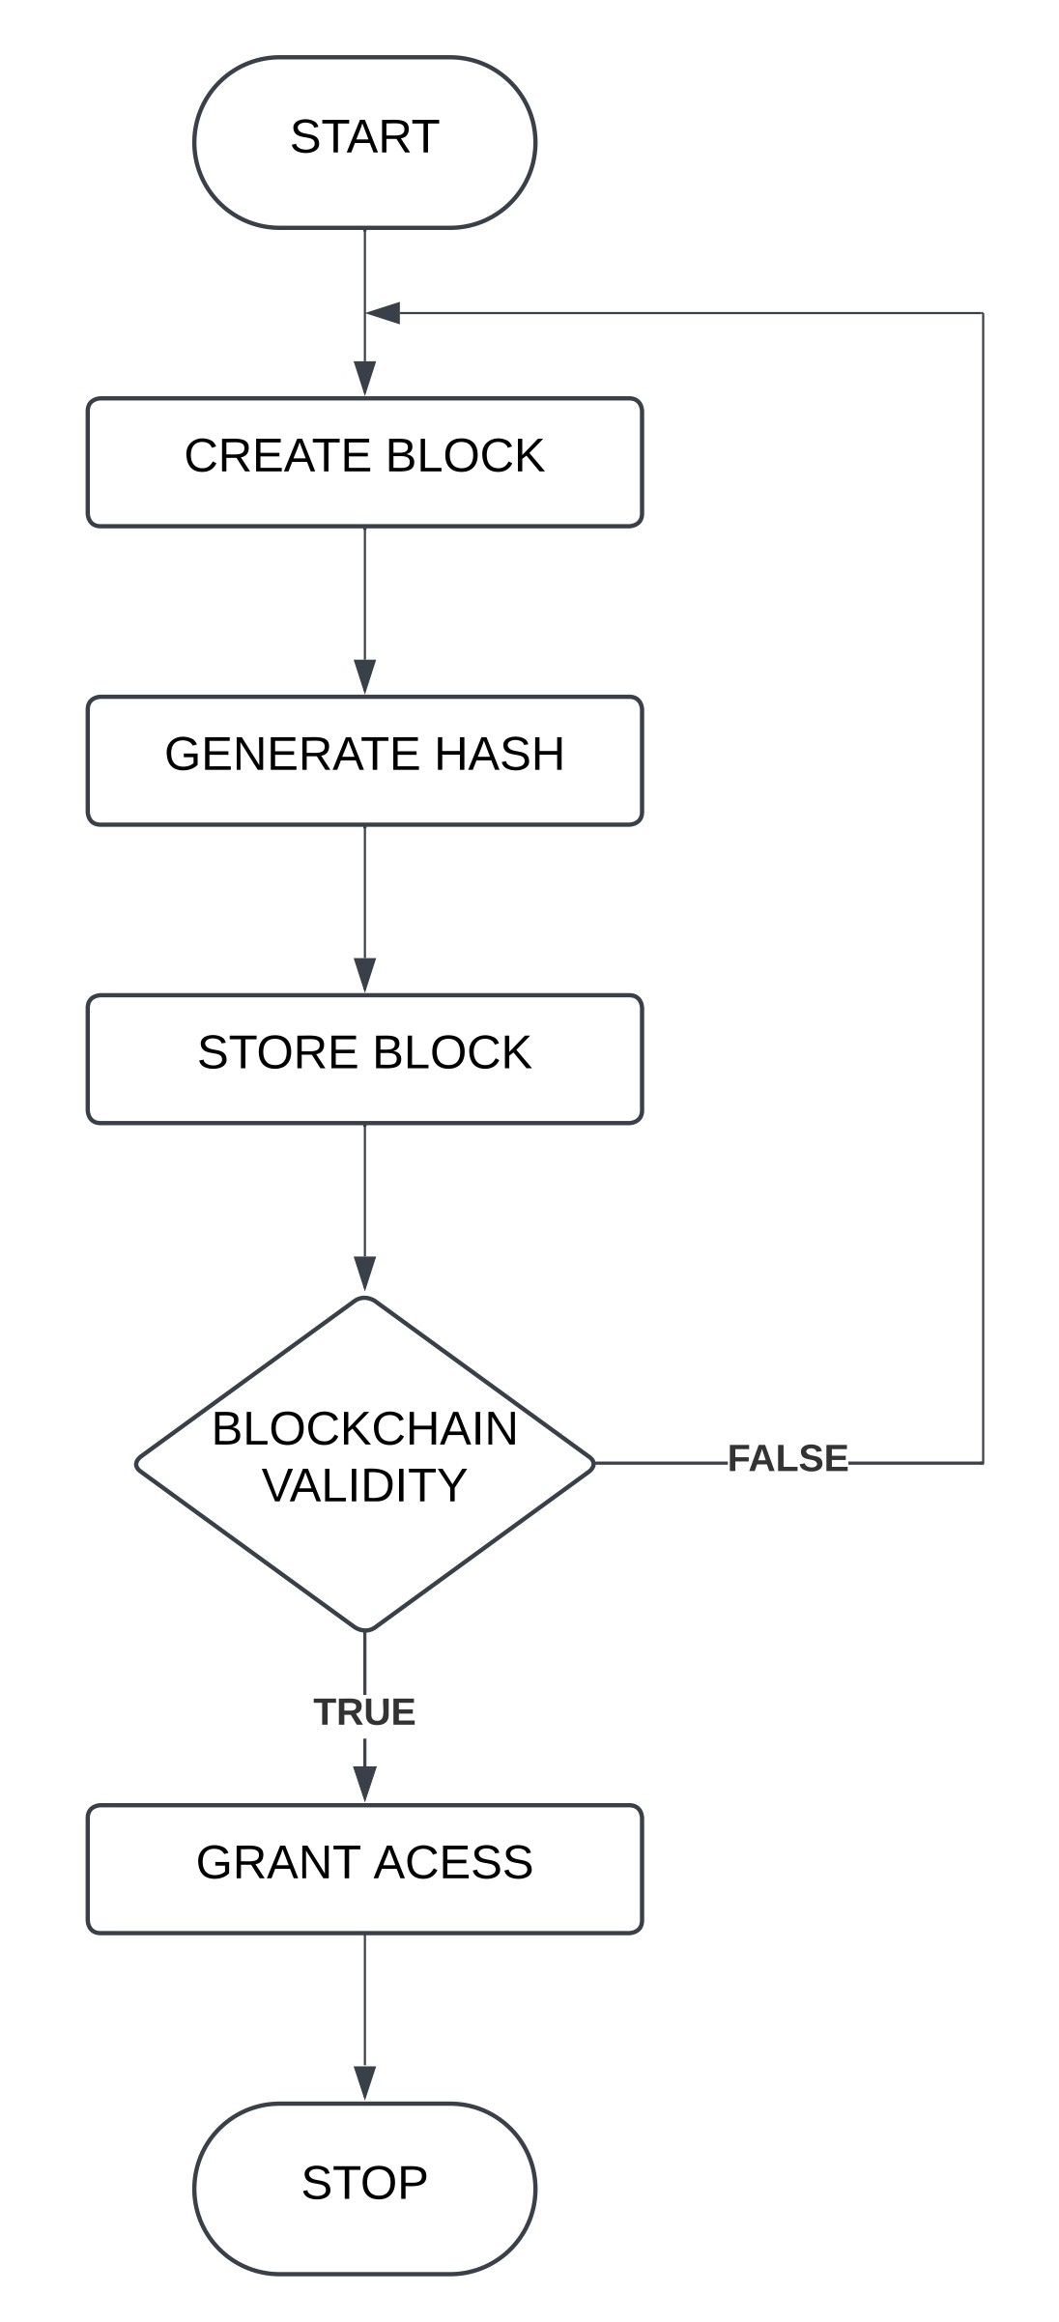
RESULT AND DISCUSSION
The blockchain process starts with a user initiating a transaction, for example, transferring some cryptocurrencies or executing a smart contract.
The transaction is broadcast to the peer-to-peer network where nodes validated this through checking cryptographic signatures and funds.
Valid transactions join a pending pool and get aggregated into a block by miners or validators.
Consensus, for example, Proof of Work or Proof of Stake, then adds the block to the blockchain.
This guarantees that the transaction is transparent, secure, and recorded permanently in the decentralized ledger.

Slide 9
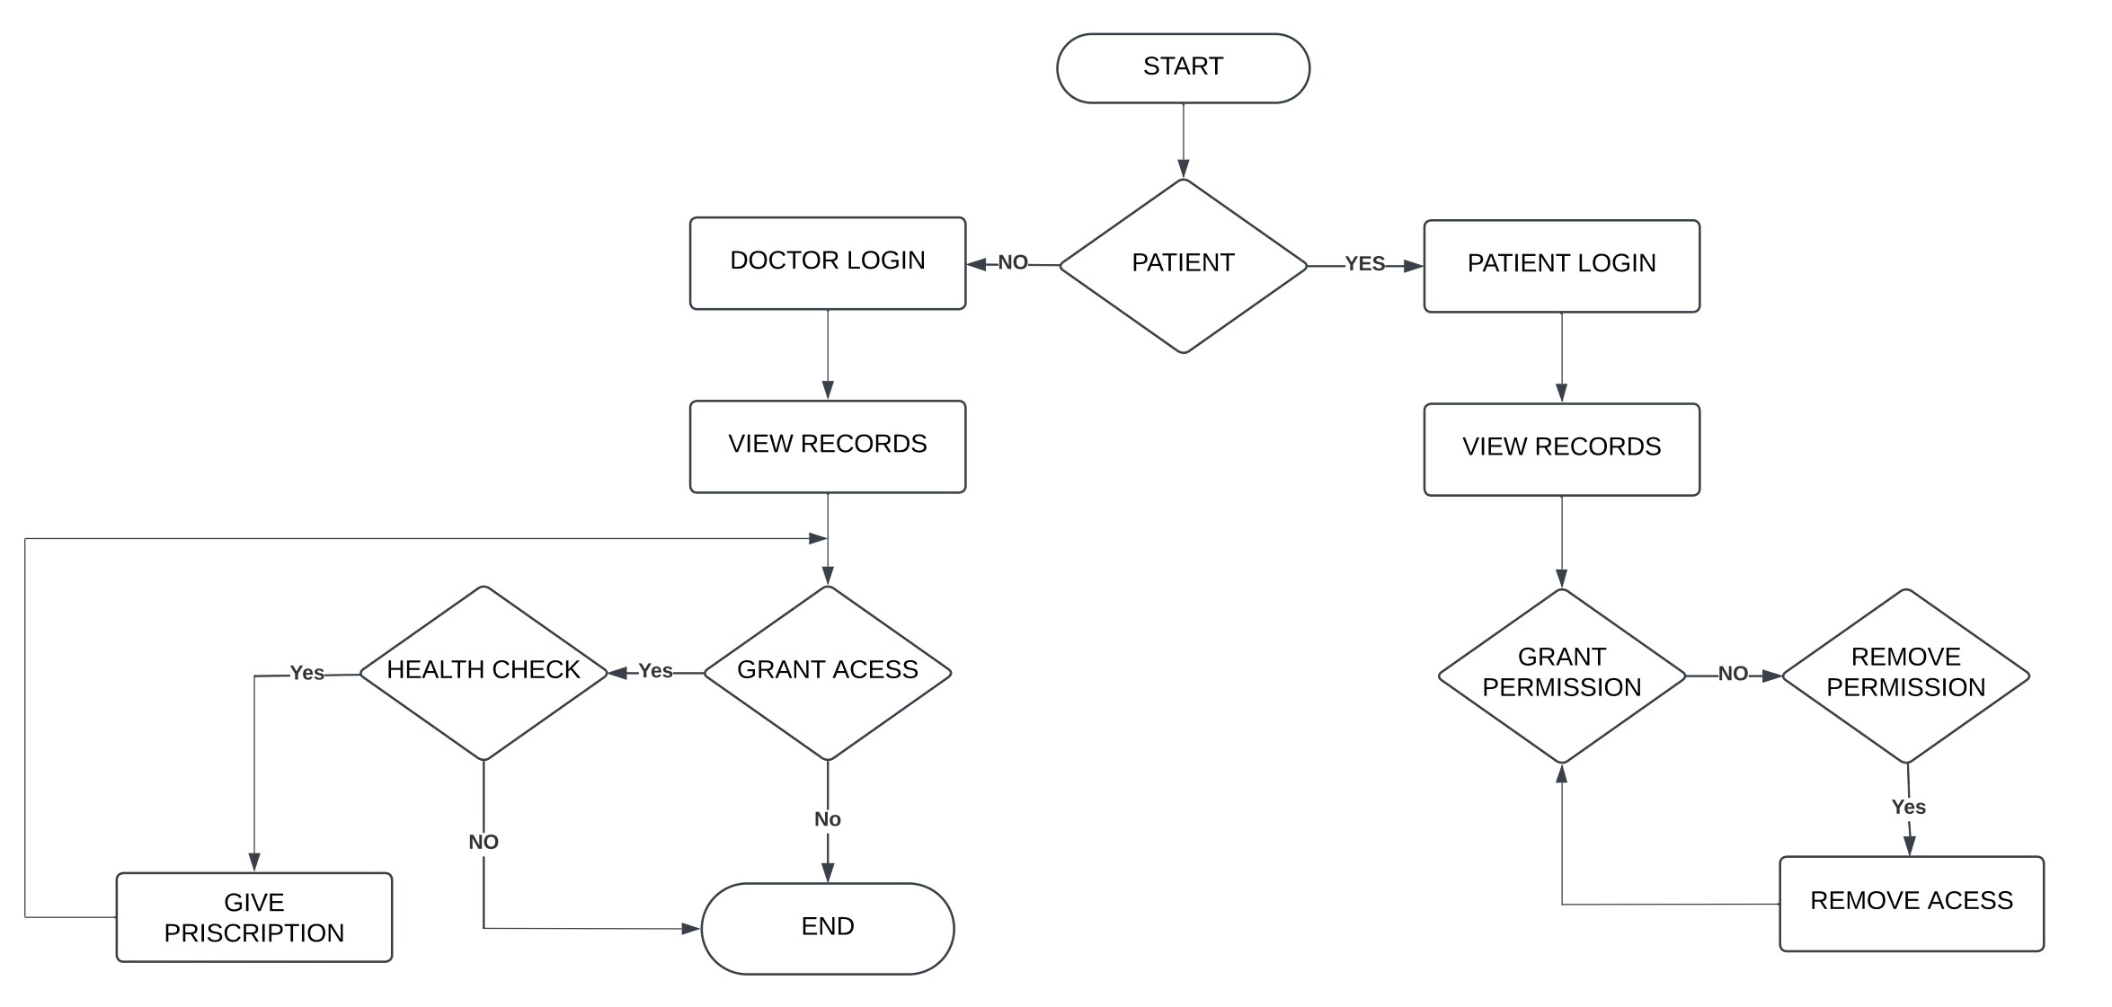
RESULT AND DISCUSSION
Hospital will have the acess of doctor and patients records.
Doctors will have the access of patients records.

Slide 10
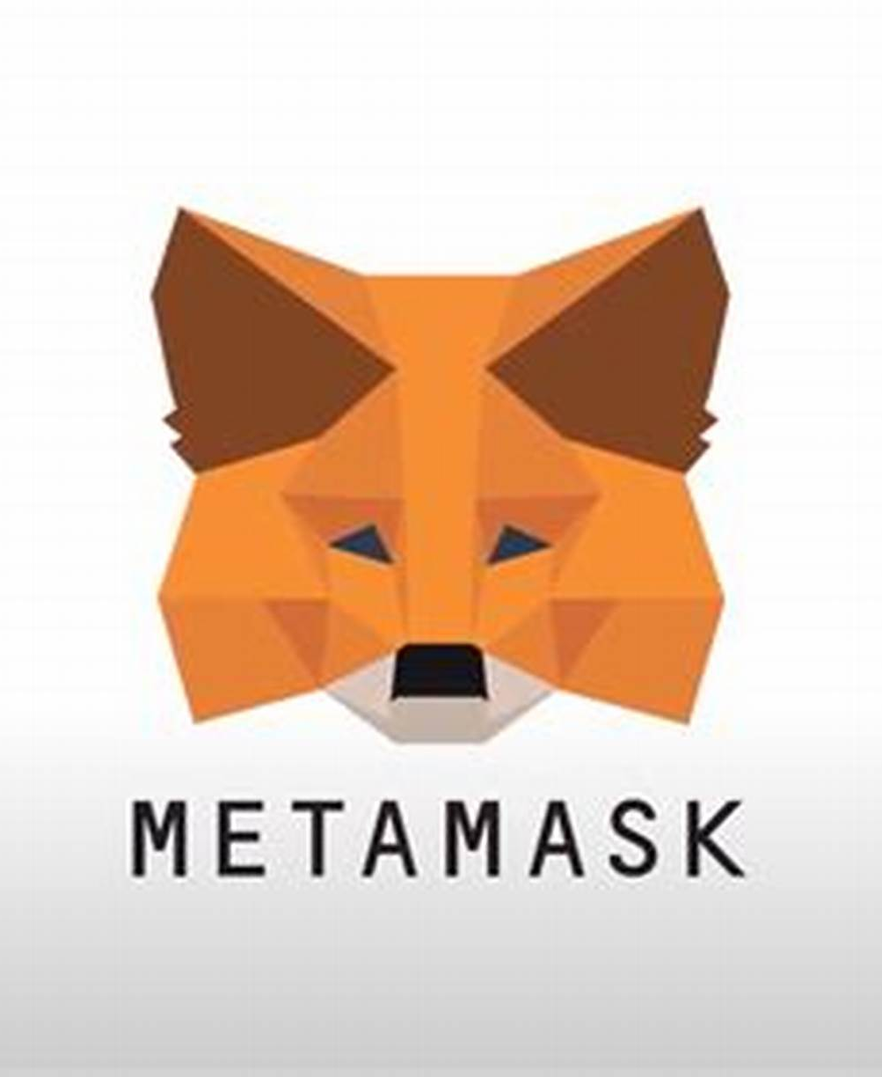
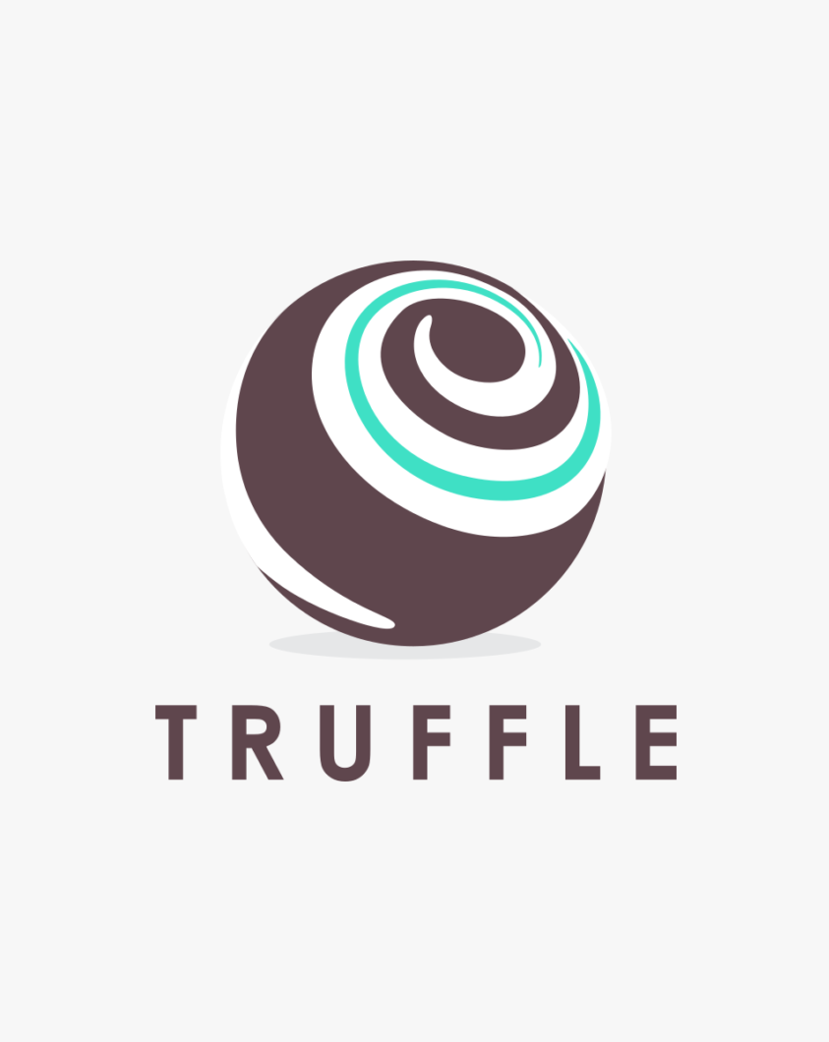
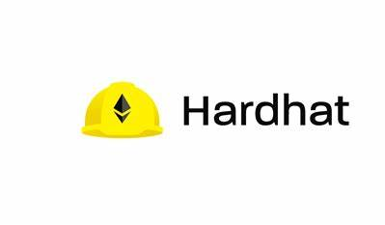
CONCLUSION AND FUTURE WORK
The present study aimed to understand the scope of the application of blockchain in the healthcare domain.
In Future I will connect the program to blockchain using Truffle / Hardhat and Metamask.

Slide 11

THANK YOU

